Slide 1






OPENSOURCE AND HACKTOBERFEST

Slide 2
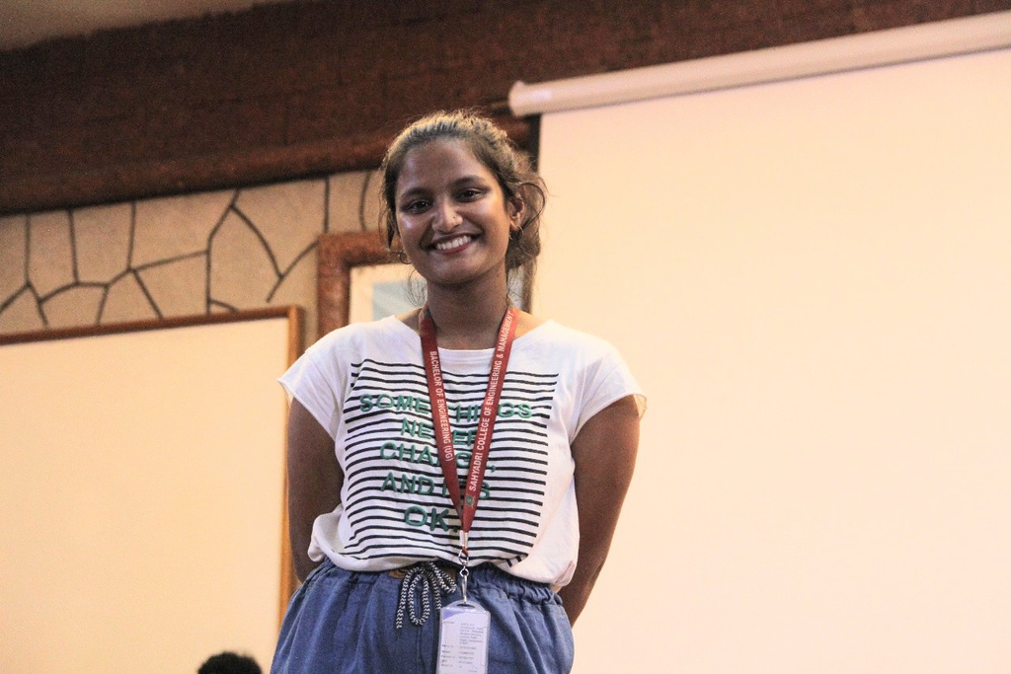
Hello guys!!!!
Nihara
SOSWC President
3rd year CSE-Data science

Slide 3




Contents
01
02
03
OPENSOURCE
GITHUB CUSTOMIZATION
GITHUB FEATUES

Slide 4





OPENSOURCE

Slide 5
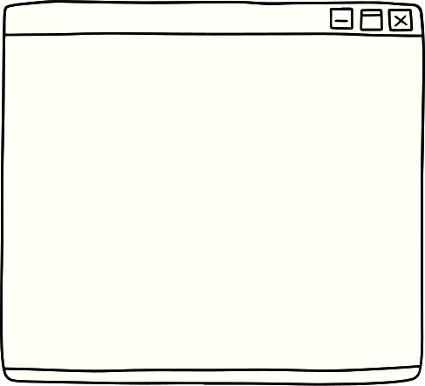





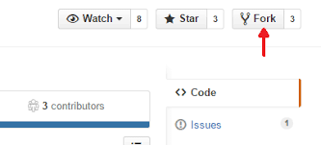

Social coding

Slide 6






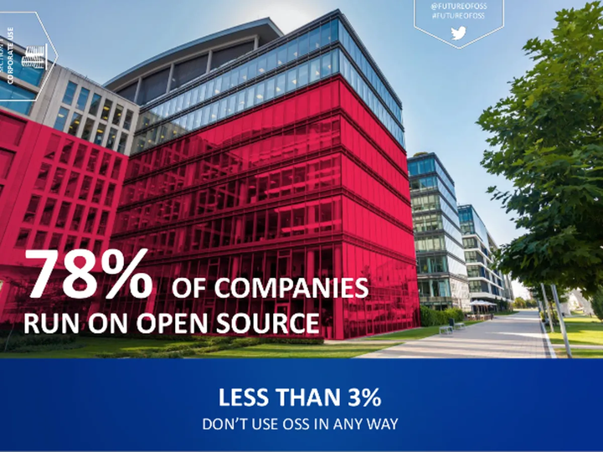


Why should you care about open source

Slide 7



Slide 8





Slide 9



Companies

Slide 10





DEMO GITHUB ACCOUNT
GITHUB ACCOUT
README GENERATOR

Slide 11













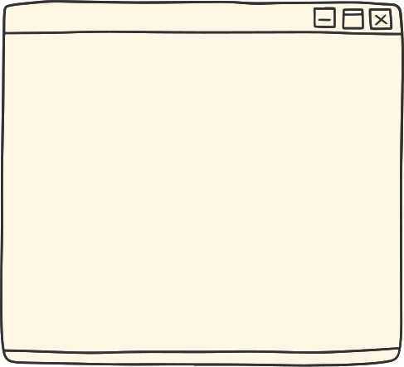


Github Alternatives

Slide 12

Thank you

